Slide 1
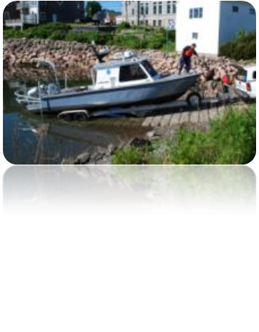
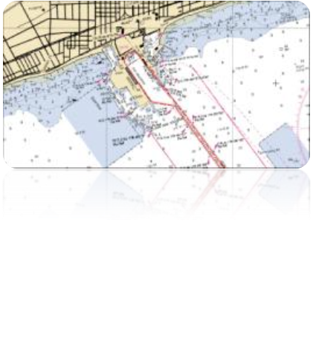
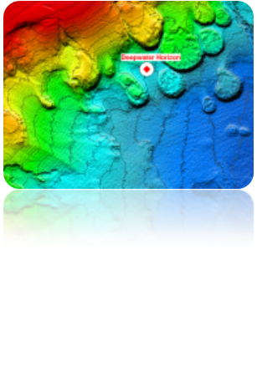

Office of Coast Survey
IHO S-100 and S-101
21st Century Framework Data Structure
for Hydrographic and Related Data

Slide 2
Why Switch to S-100 ?
Join mainstream GIS
  maximizes access to COTS software and development
New components not developed in isolation
Easier use of hydro data beyond HOs and ECDIS users
  coastal zone mapping, security, inundation modeling …
Extensible and active feature catalogue registry
  Supports dynamic feature catalogues
Plug-and-Play updating of data and symbology
  Will not need to update software to cater for changes in features and display

Slide 3
S-100 will support :
Imagery and gridded data
High-density bathymetry
Surface Currents
3-D and time-varying data (x,y,z and time)
Dynamic ECDIS
Supplementary layers - MIOs
Marine GIS
Web-based services
other maritime data applications …
Notes:
A useful diagram would be the user tasks on the left, applications e.g. ECDIS /E-Nav GIS in the middle then the data types of data product on the right, just a thought off the cuff!

Slide 4
S-100 - Framework Data Structure for Hydrographic and Related Data
  Broad geospatial framework structure
    Not specific to ECDIS or charting
    Capable of accommodating other requirements
    Increasing interest from prospective e-Navigation data providers
  Based on ISO 19100 series of geographic standards
  Multiple Encodings for different uses
    ISO 8211, GML, XML
Notes:
Product Specifications based on S-100 will be assigned a S-10x number.

Slide 5
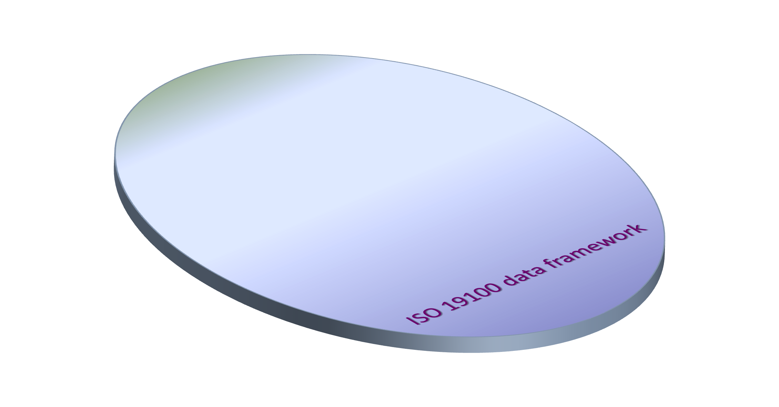
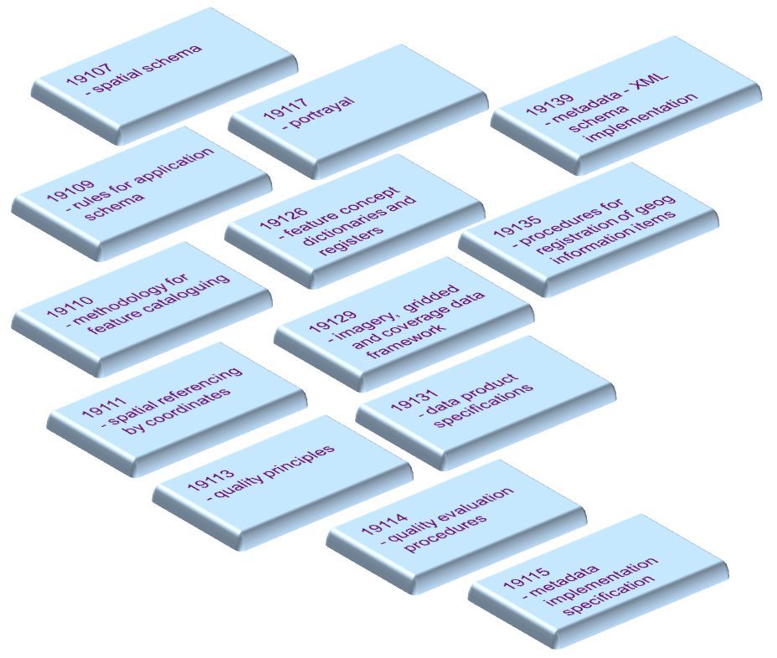

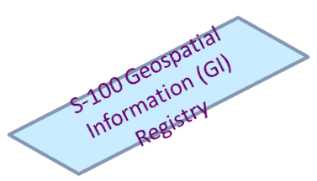

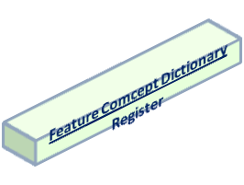
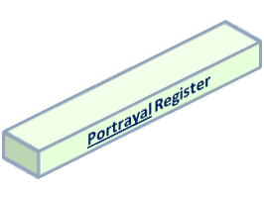



S-100 - built on ISO 19100

Slide 6
Additional Objectives
Content and carrier are independent
No need for new versions of product specifications or system revisions
    Plug-and-play updating
S-100 structure can easily accommodate present and future requirements
    ECDIS
    e-Navigation
    Inland and Port ENC
    Nautical Publications
Notes:
It should be noted that it does take time and effort and $ to develop these things.

Slide 7
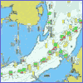

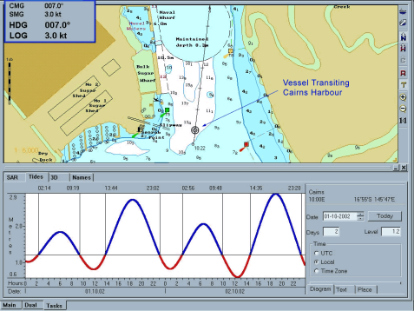
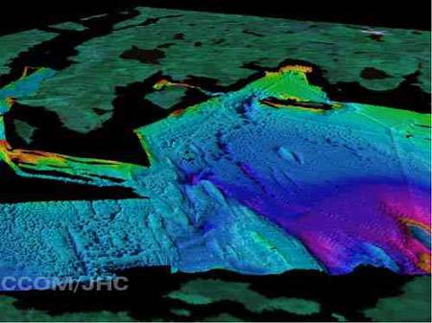

S-100 and Product Specifications
S-101 ENC
… contains all
the components
to make different
product specifications
for all types of
hydrographic data
S-100
S-102 ??
S-103 ??
S-104 ??
???????????????????????????????? ... S-10?…

Slide 8
Part Number | Part Title | Description
1 | Conceptual Schema Language | Defines the conceptual schema language and basic data types to be used with S-100
2 2a | Management of IHO Geospatial Information Registers Feature Concept Dictionary | Specifies how the IHO registry and registers will be managed and the Feature Concept Dictionary specifies definitions that may be used to describe geographic information and the use of registers to store them
3 | General Feature Model and Rules for Application Schema | Introduces the rules for developing an application schema and the creation of the general feature model. The GFM is a conceptual model for features, their characteristics and associations
4 | Metadata (General, Imagery and Gridded, Data Quality) | Specifies the metadata structure to be used in S-100
5 | Feature Catalogue | Specifies the structure of the feature catalogue – which describes the content of a data product
6 | Coordinate Reference Systems | Describes the spatial referencing by coordinates
7 | Spatial Schema | Defines the information to describe and manipulate the spatial characteristics of features
8 | Imagery and Gridded Data | Content model for gridded data for use in hydrographic applications
9 | Portrayal | Specifies the portrayal model
10 10a | Encoding formats ISO/IEC 8211 | Specifies the types of encoding formats in S-100
11 | Product Specifications | Describes how to create an S-100 Product Specification
12 | Maintenance Procedures | Specifies the maintenance procedures of S-100

Slide 9
User Requirements
Need to determine what the users want
Survey the users to determine the requirements
  This will help focus on what is needed and what pieces of S-100 will be used (product requirements)
    Hi Resolution Bathymetry
      Gridded Format
    Sailing Directions
      GML and Vector
    ENC
      Vector

Slide 10
Building a Product Specification
What is the Geometry Requirement
  Vector or Coverage (Gridded)
    This will help you determine which parts of S-100 you will need
How will the data be primarily used
  ECDIS, GIS
    This will help you determine the encoding
      8211 – vector products that are intended for use on ECDIS
      GML – Feature based products that are text heavy
      Gridded – hi resolution bathymetry

Slide 11
Building a Product Specification (Vector)
Define your real world features and attributes
  What is it that is being modeled?
  If possible re-use existing features
Determine how the features and attributes will be put together
  What is a mandatory attribute
  Is it a point, curve or surface
Create a UML model of your features to better visualize
  Forms the application schema
Use the DCEG format for initial documentation
Register any new features and attributes in the IHO Registry

Slide 12
Building a Product Specification
Create a Product Specification Document
  Geometry
  Coordinate Reference Systems
  Encoding
  Metadata
  Product Delivery
TSMAD has developed a common template

Slide 13
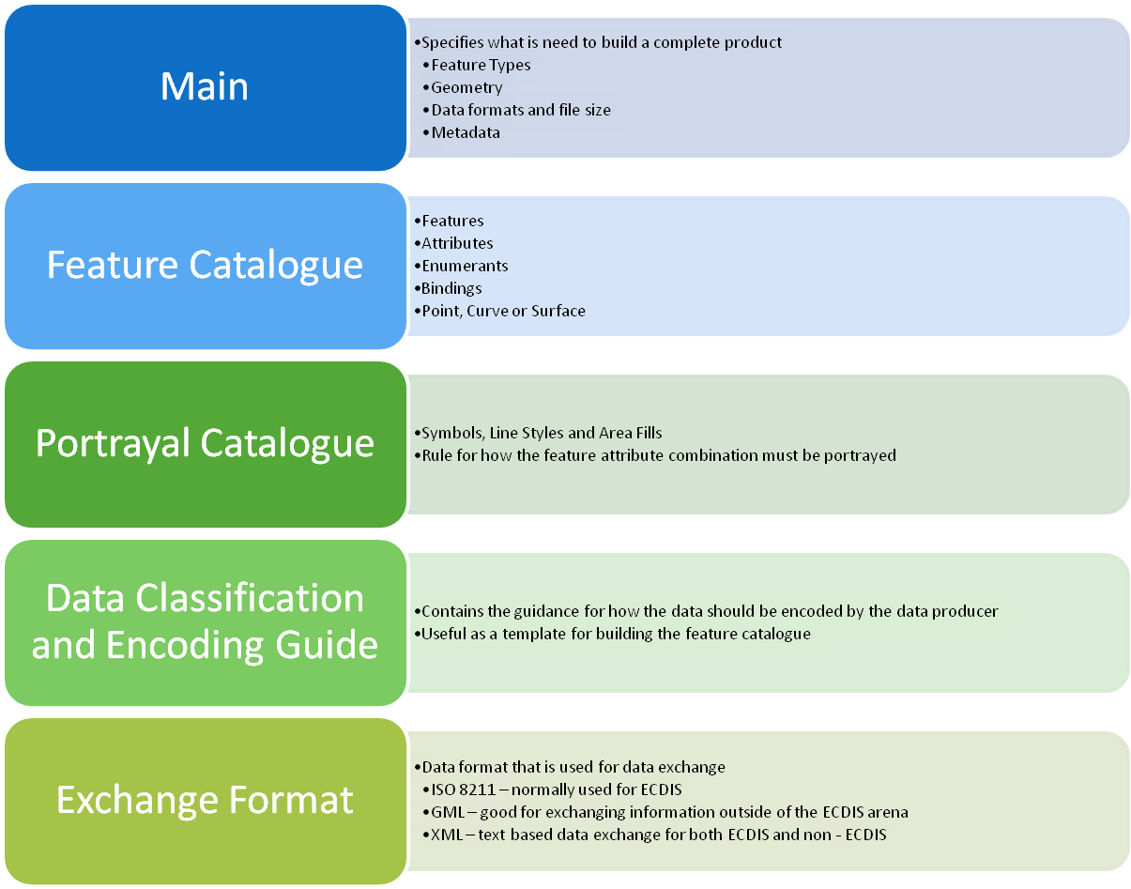
Components of an S-100 Product Specification

Slide 14
Building a Product Specification
Create an XML Feature Catalogue
Determine if you need new portrayal
Create an XML Portrayal Catalogue
Create Test Data
  Enlist the assistance of expert contributors
Organize a test bed

Slide 15

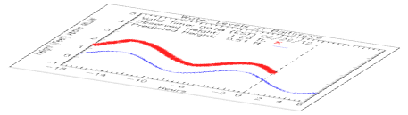
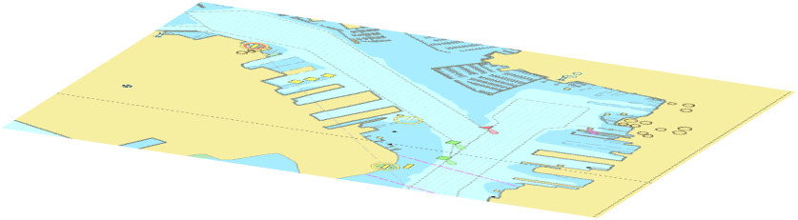
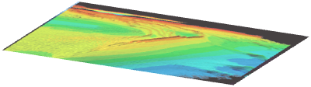
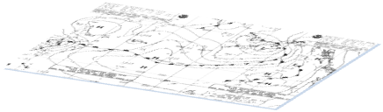
Beyond S-100
Multiple Product Specifications are in the works
  Coast Pilot Information
  Marine Protected Areas
  Surface Currents
  Ocean Forecast
S-10X Nautical Publications
S-10X Tides
S-102 Bathymetry
S-101 ENC
WMO – Met Ocean

Slide 16
What does this all mean?
Improved Standardization between hydrographic products
Improved data interoperability
Data is not just for Shipboard Navigation

Slide 17


